Slide 1

Subscribes Galore: Exploring World’s Top You tube Channels
submitted by
VINOTHINI.A
VINOTHINI.V
VINOTHA.K
VISHNUPRIYA.R
Submitted by
VINOTHINI.A
VINOTHINI.V
VINOTHA.K
VISHNUPRIYA.R

Slide 2
1.INTRODUCTION 1.1OVERVIEW
YouTube is an online video sharing and social media platform headquartered in San Bruno, California, United States. Accessible worldwide.
It was launched on February 14, 2005, by Steve Chen, Chad Hurley, and Jawed Karim.
It is owned by Google and is the second most visited website in the world, after Google Search.

Slide 3
1.2 PURPOSE
YouTube is a free video sharing website that makes it easy to watch online videos.
You can even create and upload your own videos to share with others.
Originally created in 2005, YouTube is now one of the most popular sites on the Web, with visitors watching around 6 billion hours of video every month.
Live Captioning.
Reporting/Analytics.
Social Sharing.
Speech Recognition.
Subtitles/Closed Captions.
Text Overlay.
Time Stamps.
Audio/video file upload.

Slide 4
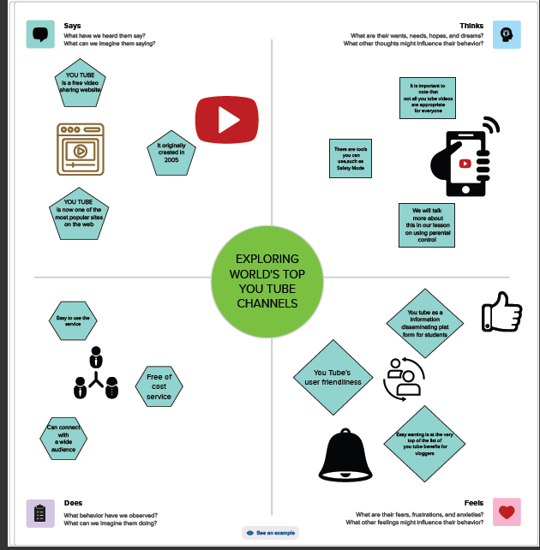
2. PROBLEM DEFINITION/DESIGN THINIKING MILESTONE 1:DEFINE PROBLEM/PROBLEM UNDERSTADING 2.1 EMPATHY MAP

Slide 5
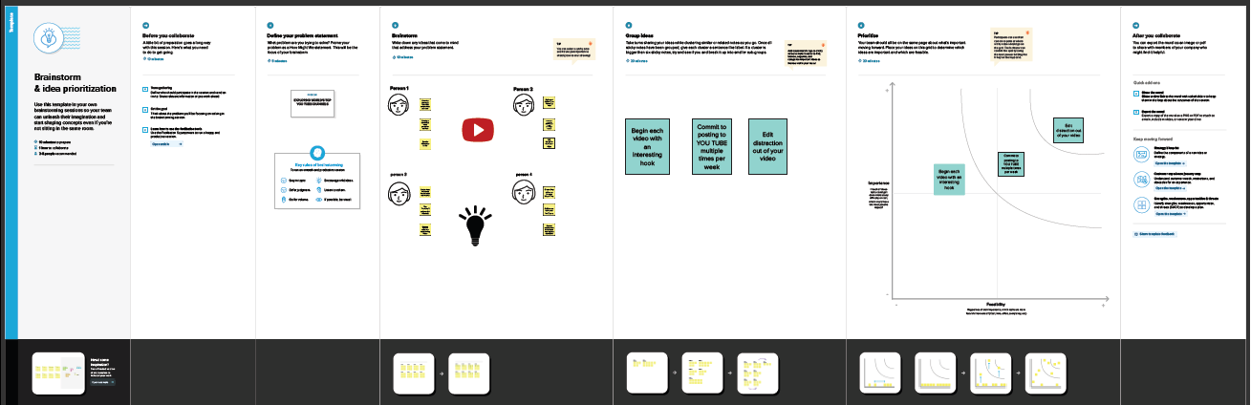
2.2 IDEATIONS AND BRAINSTORMING

Slide 6
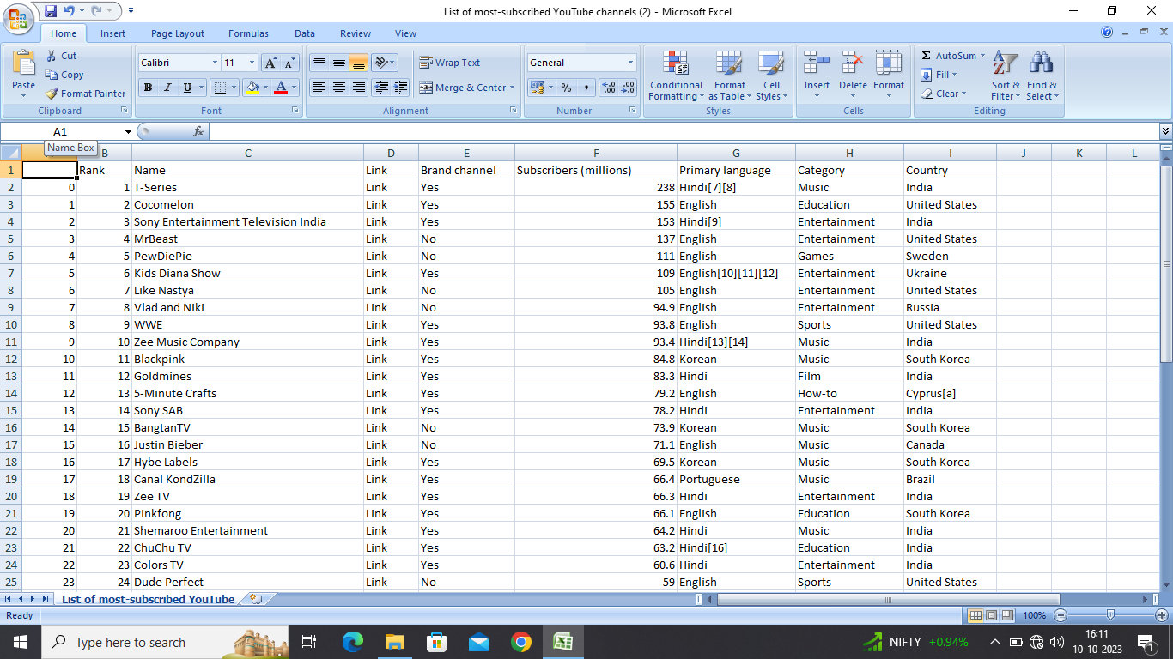
RESULT: MILESTONE 2: DATA COLLECTION & EXTRACTION FROM DATABASE
Data collection is the process of gathering and measuring information on variables of interest, in an established systematic fashion that enables one to answer stated research questions, test hypotheses, and evaluate outcomes and generate insights from the data

Slide 7
Activity 1.1: Understand the data Data consists of 52 rows and 9 columns that correspond the different TOP YOUTUBE CHANNELS and more subscribers in the world column description for the Tableau: Top most you tube channels and subscribers
Rank – It represents the top list in the world.
Name – It represents the name of you tube channels.
Link- It represents the you tube channels URL code.
Brand channels- It represents different type of you tube channels.
Subscribers- It represents no. of people follow the channels.
Primary language- It represents no. of languages in view of you tube channels.
Category- It represents the theme of you tube videos.
Country- It represents top you tube channels in the world.

Slide 8
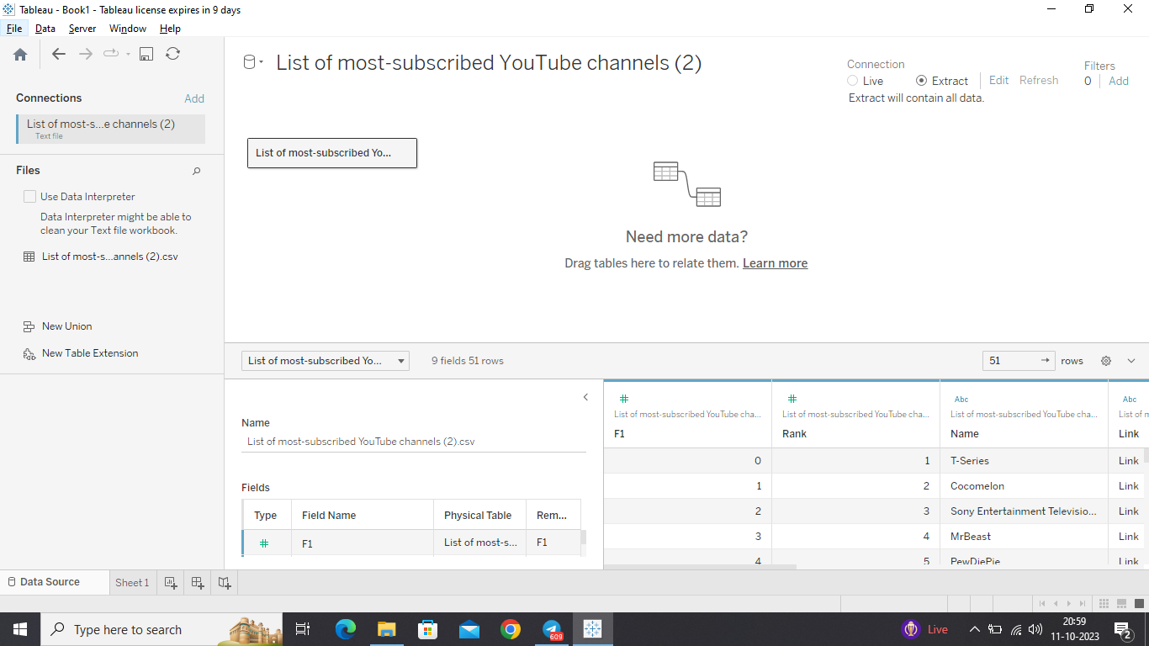
Activity 2: Connect Dataset with Tableau

Slide 9
MILESTONE3: DATA PREPARATION Activity 1: Prepare the Data for Visualization
Preparing the data for visualization involves cleaning the data to remove irrelevant or missing data, transforming the data into a format that can be easily visualized, exploring the data to identify patterns and trends, filtering the data to focus on specific subsets of data, preparing the data for visualization software, and ensuring the data is accurate and complete. This process helps to make the data easily understandable and ready for creating visualizations to gain insights into the performance and efficiency

Slide 10
MILESTONE 4: DATA VISUALIZATION
Data visualization is the process of creating graphical representations of data in order to help people understand and explore the information. The goal of data visualization is to make complex data sets more accessible, intuitive, and easier to interpret. By using visual elements such as charts, graphs, and maps, data visualizations can help people quickly identify patterns, trends, and outliers in the data
Activity 1: No of Unique Visualizations
The number of unique visualizations that can be created with a given dataset

Slide 11
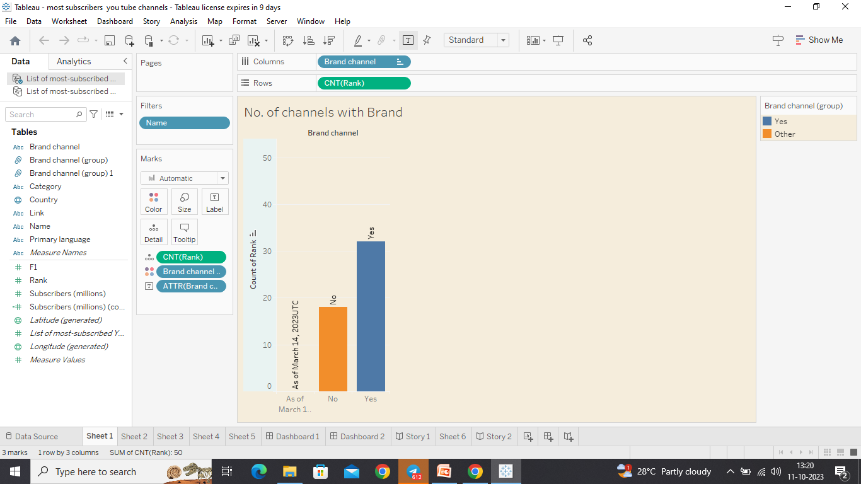
Activity 1.1 NUMBER OF CHANNELS WITH BRAND

Slide 12
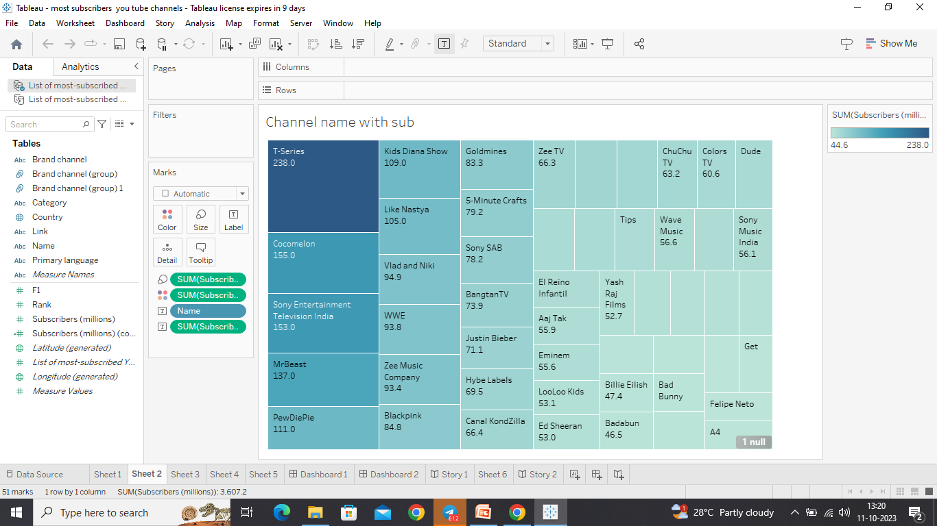
Activity 1.2 CHANNEL NAME WITH SUBSCRIBERS

Slide 13
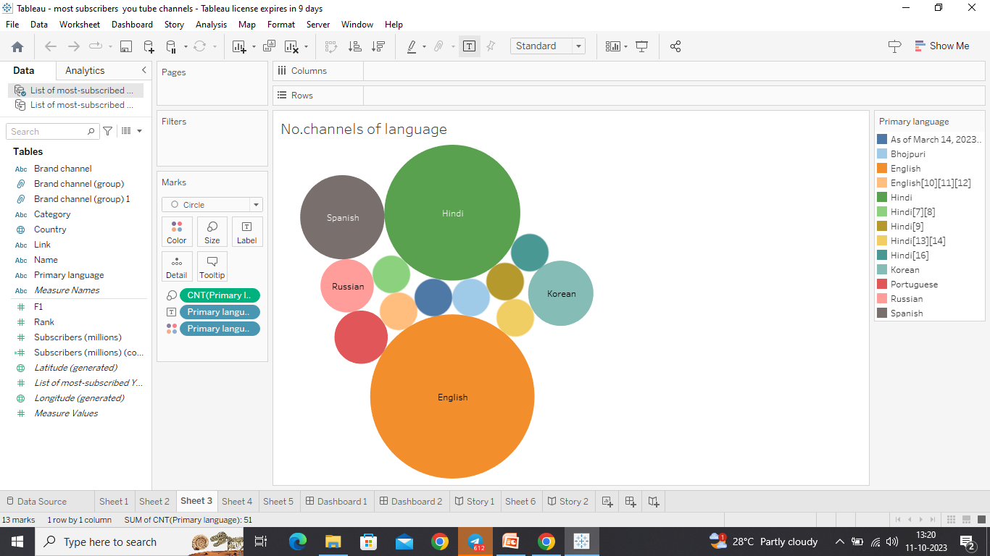
Activity 1.3 NUMBER CHANNELS OF LANGUAGE

Slide 14
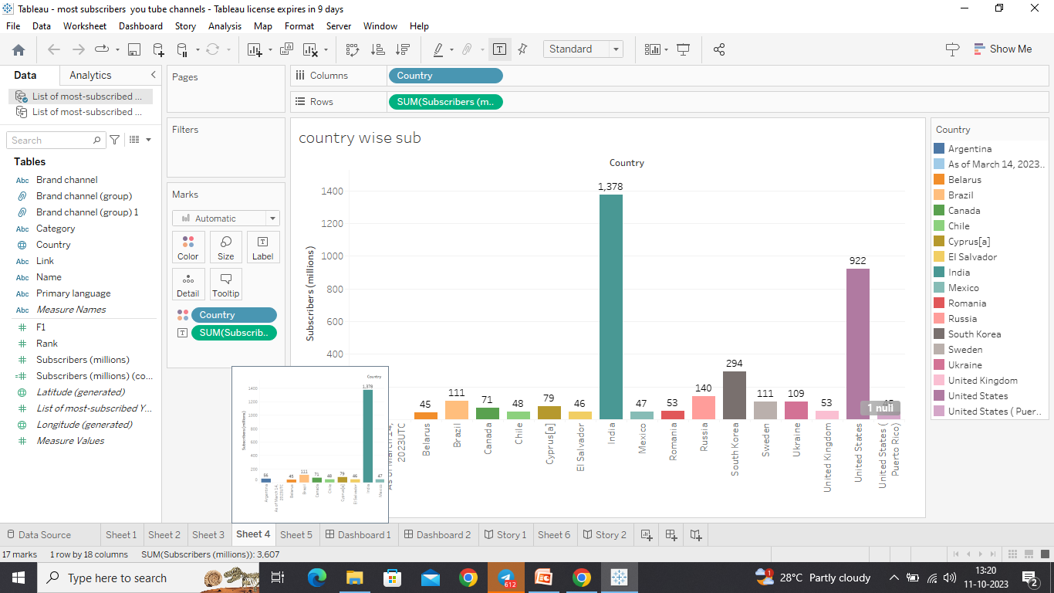
Activity1.4:COUNTRY WISE SUBSCRIBERS

Slide 15
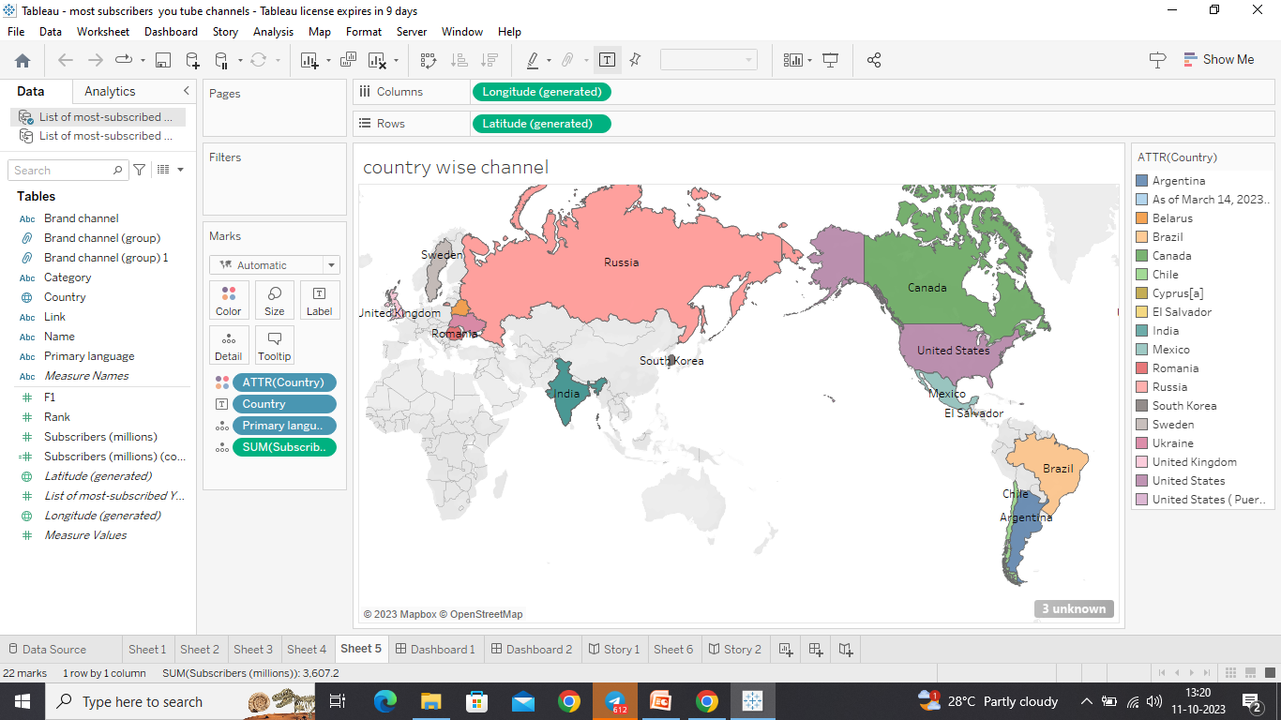
Activity 1.5: COUNTRY WISE CHANNELS

Slide 16
Milestone 5: DASHBOARD
A dashboard is a graphical user interface (GUI) that displays information and data in an organized, easy-to-read format. Dashboards are often used to provide real time monitoring and analysis of data, and are typically designed for a specific purpose or use case. Dashboards can be used in a variety of settings, such as business, finance, manufacturing, healthcare, and many other industries
Activity 1: Responsive and Design of Dashboard
The responsiveness and design of a dashboard for the tableau top most you tube channels subscribers is crucial to ensure that the information is easily understandable and actionable

Slide 17
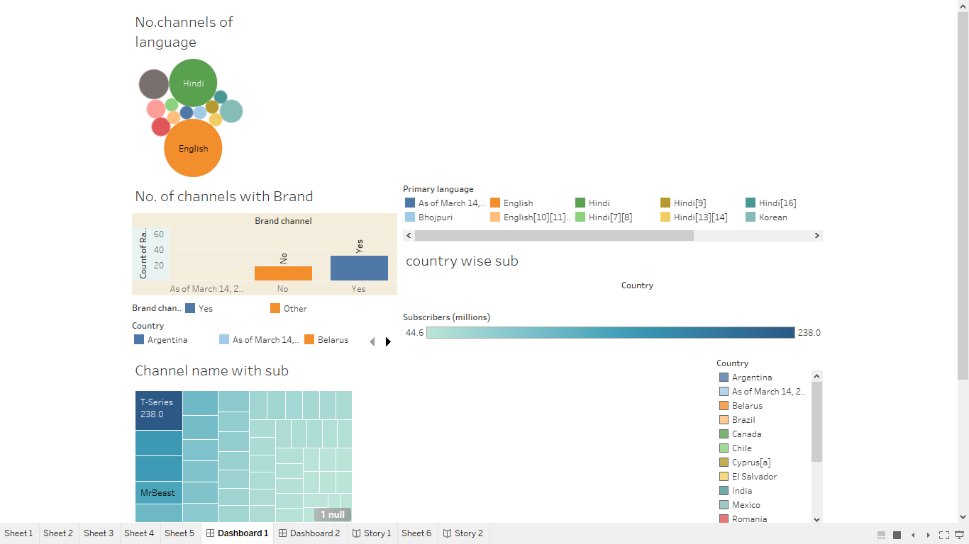
Activity 1: you tube dashboard

Slide 18
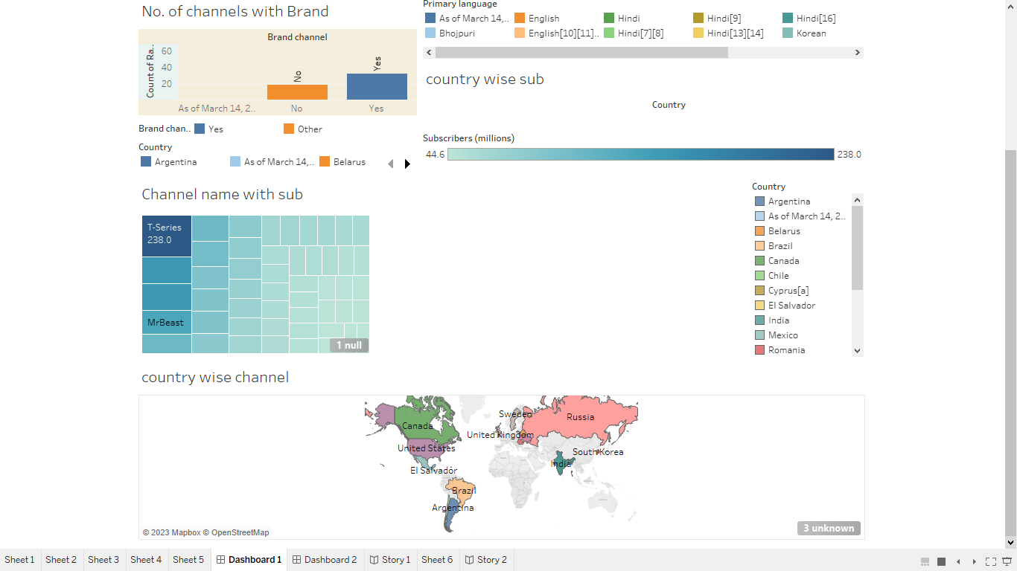

Slide 19
MILESTONE 6: STORY
A data story is a way of presenting data and analysis in a narrative format, with the goal of making the information more engaging and easier to understand
Activity 1: No Of Scenes Of Story
The number of scenes in a storyboard for a data visualization analysis vehicle collisions will depend on the complexity of the analysis and the specific insights that are trying to be conveyed

Slide 20
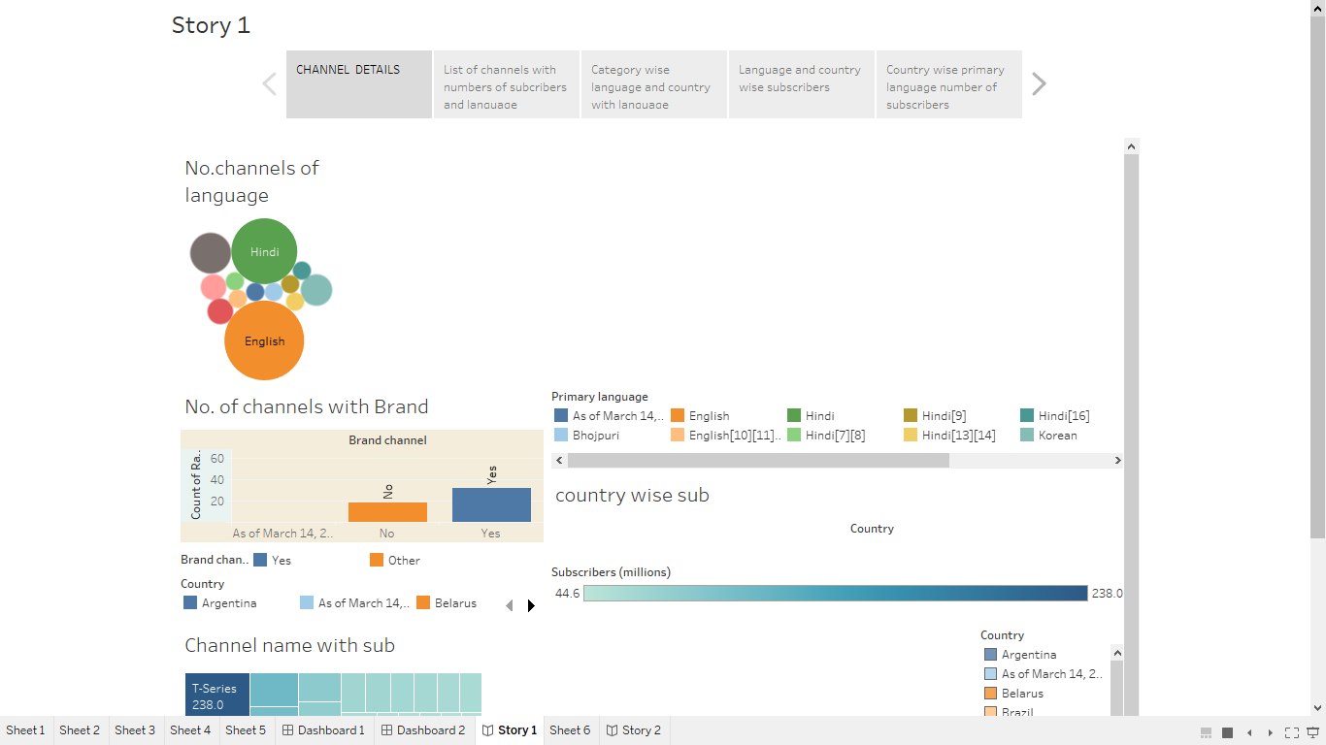
Activity1.1: you tube storyline

Slide 22
MILESTONE 7: PERFORMANCE TESTING
Activity 1: Utilization Of Data Filters

Slide 23
Activity1.2: graphs

Slide 24
THANK YOU

